Slide 1

Digital Forensics
Assignment 1
A GRAFF 2231290

Slide 2
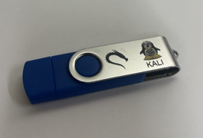
Before we begin
I will be using an 8gb USB flash drive as our CSF that has two partitions.
Partition #1 50mb fat32 file system
(Partition #2 7.45gb unallocated file system)
As we will not need to use the entire USB

Slide 3
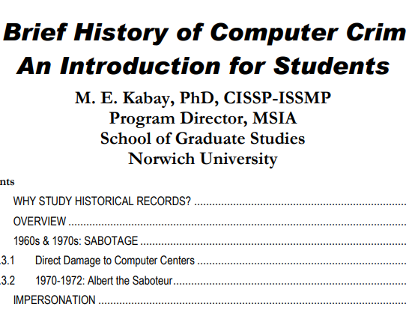
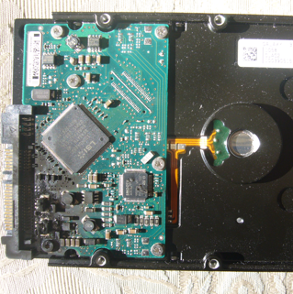
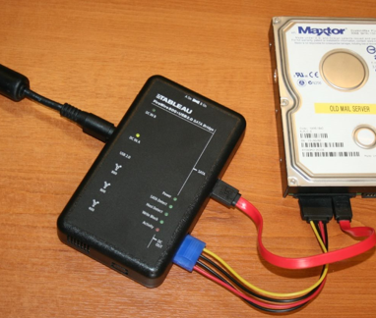
Preparation Phase
In Linux,
The three files we are going to move onto the CSF (USB) are:
HD_with_toasty_PCB.jpg
Portable_forensic_tableau.jpg
history.pdf
Now the 3 files have been successfully moved on to the CSF (USB)
We will now forensically wipe the CSF (USB)
Notes:
First of all we are going to select three files and put these onto the CSF (USB) file and then perform a forensic wipe of the CSF

Slide 4
Forensically Wipe
Using Kali Linux, we will need to identify the USB drive using “sudo fdisk –l”
Overwrite the data using “sudo shred –vzn 3 /dev/sdb1”
This command will overwrite the USB drive with zero’s 3 times over, hence forensically wiping to an extent
Notes:
Because we are using Linux, we will enter some commands to perform this operation
We will identify the USB drive that we will forensically wipe using terminal. The command we will enter is “sudo fdisk –l” this command will give us some information about partition tables from specified devices
The next command we will enter is “shred –vzn 1”

Slide 5

Create Suspicious Folder
In Windows,
Create “Suspicious” folder
Create an xlsx file named “CC_2231290”
Prepare this with 4 rows of credit card numbers as per instructions
Notes:
We will now create an excel file named “CC_2231290” and save as an xlsx file
We will copy rows from the credit card excel spreadsheet named “Auxilary File 2”
We +5 (add 5) to the last digit of my ID number which is “0”
So the first record we use is the 5th, 15th, 25th and 35th row.
I will copy these cells and add it to the excel file we have created
I will copy the Excel sheet into “Suspicious”

Slide 6
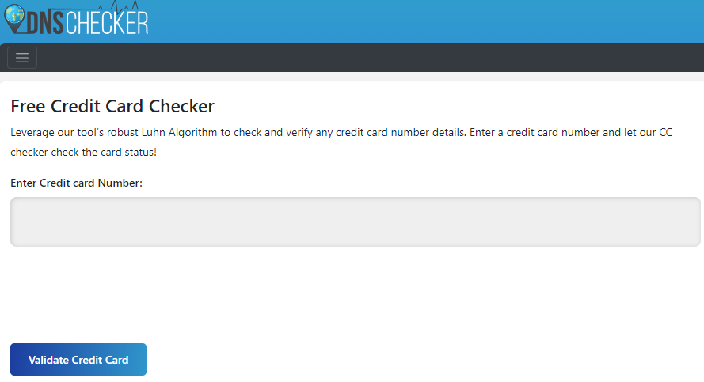
Analysis 1
Check 4 credit cards using dnschecker.org
Row 5. 4929482580871 pass
Row 15. 4539622125154 pass
Row 25. 344202721442892 pass
Row 35. 346536544295303 null
Notes:
dnschecker.org

Slide 7
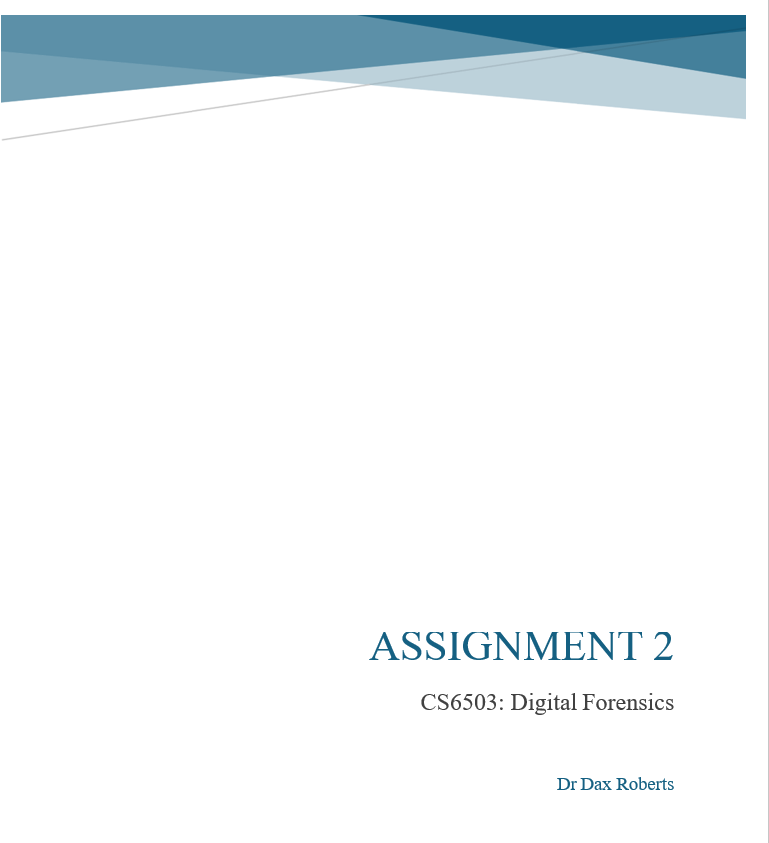
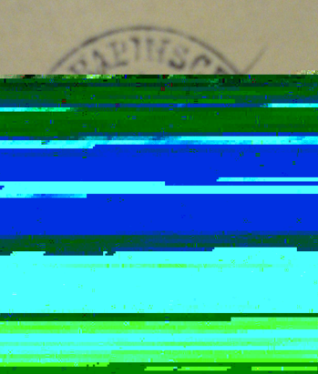
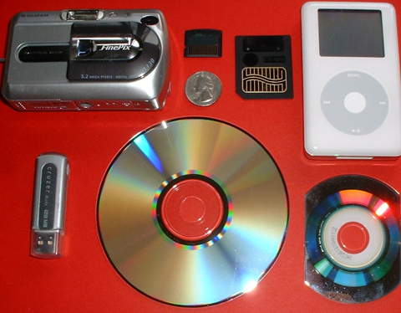
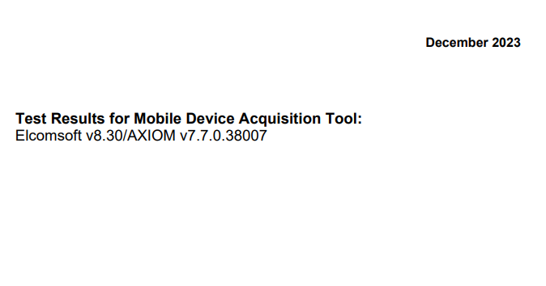
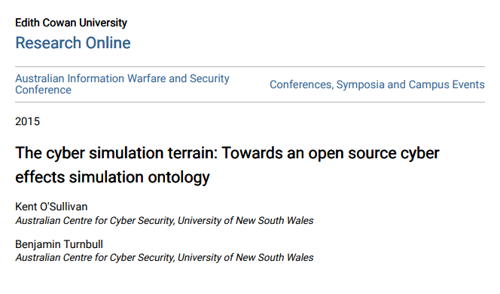
Add 5 more files
Assignment 2.doc | Data_loss_of_image_file.img | personal storage devices.jpg | Sub24_0513.. pdf | cybersimulation.pdf

Slide 8
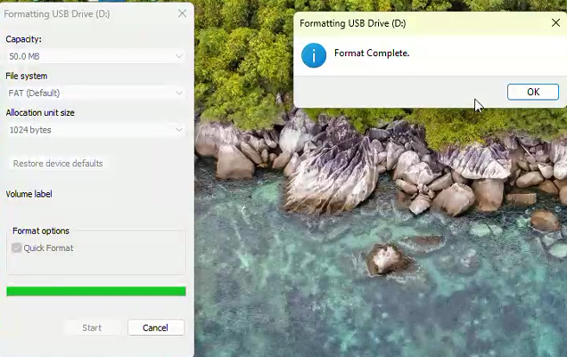
Quick format using Windows
This is the end of our preparation phase

Slide 9
Describe each tool
Scalpel (Data carving)
Foremost (File recovery)
Autopsy (GUI digital forensic analysis)
Notes:
Scalpel is a data carving tool used in Kali Linux CLI. The tool I use here is the scalpel version 1.60 that has been pe-installed in my virtual kali linux machine. This tool when data carving requires a set up in a configuration file. The file is called scalpel.conf where we specify file types we are carving from in nano. Once this is done we perform the scalpel data carving operation. At the end of processing it produces a audit.txt file of our findings.
2. Foremost is a data carving and file recovery tool. Another tool we use in the kali linux terminal. It is simple and effective that carves and recovers files by reading the headers and footers of the files. Foremost also provides a list audit.txt of our findings and also has a total file extraction section to summarise the types of files it has extracted, which is neat.
3. Autopsy is a nice GUI to perform cyber forensic investigations. There are multiple functions available to us when performing a digital forensic analysis. This tool we will use in windows and see what we can extract from the CSF USB file. The version we will be using is the Autopsy 4.21.

Slide 10
Image capture the USB
We will capture an image of the CSF USB file
Locate the usb drive “fdisk –l”
Entering “sudo dd if=/dev/sdb1 of=~usb-csf.img bs=4M”

Slide 11
Report what the tools found
Scalpel
Files expected to be found: 6 (xlsx, word.doc, jpg 2, pdf 2)
Files found: 67
Time taken to find the files: 2 seconds
Notes:
Now we are at a hands-on phase where we begin to examine the CSF and see what data we can recover using the three tools we discussed
I will check to see if this has been created using “ls”
Now I will use the scapel command “sudo nano /etc/scalpel/scalpel.conf”
I will make adjustments in the config file and press ctrl O to save by appending
To perform scalpel operations I will enter “scalpel –o scalpeloutput/ usb-csf.img”
We see an output of the data carving process in the audit.txt in the scalpeloutput
Clicking on the newly created file where we opted for our output (scalpeloutput), we can see all the folders that have been carved from this formatted USB

Slide 12
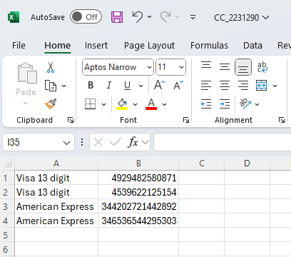
Files expected to be found
Assignment 2.doc | Data_loss_of_image_file.img | personal storage devices.jpg | Sub24_0513.. pdf | cybersimulation.pdf | CC_2231290.xslx

Slide 13


What the Scalpel tool did find
Assignment 2.doc | Data_loss_of_image_file.img | personal storage devices.jpg | Sub24_0513.. pdf | cybersimulation.pdf | CC_2231290.xslx

Slide 14
Report what the tools found
Foremost
Files expected to be found: 6 (xlsx, word.doc, jpg 2, pdf 2)
Files found: 27
Time taken to find the files: 3 seconds
Notes:
Now we are at a hands-on phase where we begin to examine the CSF and see what data we can recover using the three tools we discussed
While using the same usb file image capture
At the main menu,
We enter “foremost –l usb-csf.img –o foremostoutput”
We can “ls” and see the new file created (foremostouput)
We can “cd” into the file and “ls” to see the files recovered
Best part is to check the results from the Foremost scan in the audit.txt file
This audit txt file has more information than scalpel, we can see the total number of files extracted
We can also see the type of files extracted
Lets see the files in the GUI

Slide 15
Files expected to be found
Assignment 2.doc | Data_loss_of_image_file.img | personal storage devices.jpg | Sub24_0513.. pdf | cybersimulation.pdf | CC_2231290.xslx

Slide 16
What Foremost tool did find
Assignment 2.doc | Data_loss_of_image_file.img | personal storage devices.jpg | Sub24_0513.. pdf | cybersimulation.pdf | CC_2231290.xslx

Slide 17
Report what the tools found
Autopsy
Files expected to be found: 6 (xlsx, word.doc, jpg 2, pdf 2)
Files found: 6
Time taken to find the files: 2.15 min
Notes:
Now we are at a hands-on phase where we begin to examine the CSF and see what data we can recover using the three tools we discussed
Lastly, we will use Autopsy a GUI tool using a Windows Operating System.
Instead of the image we will be inserting the formatted USB to perform our data recovery
As we navigate through the Autopsy we can see the deleted files in the carved section of our D:/ drive

Slide 18
Files expected to be found
Assignment 2.doc | Data_loss_of_image_file.img | personal storage devices.jpg | Sub24_0513.. pdf | cybersimulation.pdf | CC_2231290.xslx

Slide 19
What Autopsy tool did find
Assignment 2.doc | Data_loss_of_image_file.img | personal storage devices.jpg | Sub24_0513.. pdf | cybersimulation.pdf | CC_2231290.xslx

Slide 20
Analysis 2
Add 2 new folders “Test 2024” and “Innocuous_T2” to the CSF
Insert any 4 flags from https://en.wikipedia.org/wiki/List_of_New_Zealand_flags
into “Innocuous_T2”
Insert assignment descriptor PDF into “Test 2024”
Delete “Test 2024”
Notes:
Now we are back at windows and inserting the CSF (USB)
We will create two new folders Test 2024 and Innocuous_T2
Clicking on this link here, we will drag 4 flags to the Innocuous_T2 folder.
In the Test 2024 folder we will insert the “assignment descriptor pdf file”
I will now delete Test 2024

Slide 21
Report what the tools found
Scalpel
Files expected to be found: 7
Files found: 42
Time taken to find the files: 2 seconds
Notes:
We access kali linux and the first thing we want to do is clone the CSF (USB) drive
At the main menu,
Enter “sudo fdisk –l”
We enter “sudo dd if=/dev/sdb1 of=~/usb-csf2.img bs=4M”
I will check to see if this has been created using “ls”
Now I will use the scapel command “sudo nano /etc/scalpel/scalpel.conf”
I will make adjustments in the config file and press ctrl O to save by appending
To perform scalpel operations I will enter “scalpel –o scalpeloutput2/ usb-csf2.img”
We see an output of the data carving process in the audit.txt in the scapeloutput2
Clicking on the newly created file where we opted for our output (scalpeloutput2), we can see all the folders that have been carved from this formatted USB

Slide 22
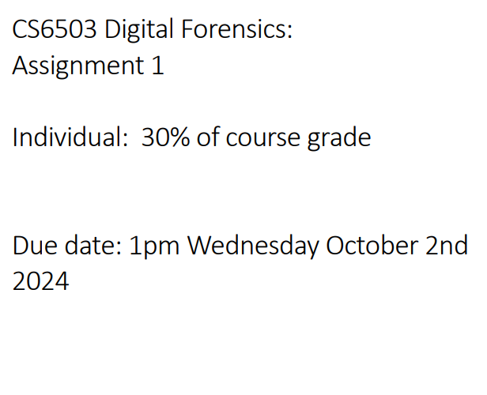
Files expected to be found
2024 CS6503_A1.pdf | Assignment 2.doc | Data_loss_of_image_file.img | personal storage devices.jpg | Sub24_0513.. pdf | cybersimulation.pdf | CC_2231290.xslx

Slide 23
What scalpel did find
2024 CS6503_A1.pdf | Assignment 2.doc | Data_loss_of_image_file.img | personal storage devices.jpg | Sub24_0513.. pdf | cybersimulation.pdf | CC_2231290.xslx

Slide 24
Report what the tools found
Foremost
Files expected to be found: 7
Files found: 30
Time taken to find the files: 2 seconds
Notes:
Now we are at a hands-on phase where we begin to examine the CSF and see what data we can recover using the three tools we discussed
While using the same usb file image capture
At the main menu,
We enter “foremost –i usb-csf2.img –o foremostoutput2”
We can “ls” and see the new file created (foremostoutput2)
We can “cd” into the file and “ls” to see the files recovered
Best part is to check the results from the Foremost scan in the audit.txt file
This audit txt file has more information than scalpel, we can see the total number of files extracted
We can also see the type of files extracted
Lets see the files in the GUI

Slide 25
Files expected to be found
2024 CS6503_A1.pdf | Assignment 2.doc | Data_loss_of_image_file.img | personal storage devices.jpg | Sub24_0513.. pdf | cybersimulation.pdf | CC_2231290.xslx

Slide 26
What Foremost did find
2024 CS6503_A1.pdf | Assignment 2.doc | Data_loss_of_image_file.img | personal storage devices.jpg | Sub24_0513.. pdf | cybersimulation.pdf | CC_2231290.xslx

Slide 27
Report what the tools found
Autopsy
Files expected to be found: 7 f
Files found: 4
Time taken to find the files: 3.26 mins
Notes:
Lastly, we will use Autopsy a GUI tool using a Windows Operating System.
Instead of the image we will be inserting the USB to perform our data recovery
As we navigate through the Autopsy we can see the deleted files in the carved section of our D:/ drive

Slide 28
Files expected to be found
2024 CS6503_A1.pdf | Assignment 2.doc | Data_loss_of_image_file.img | personal storage devices.jpg | Sub24_0513.. pdf | cybersimulation.pdf | CC_2231290.xslx

Slide 29
What Autopsy did find
2024 CS6503_A1.pdf | Assignment 2.doc | Data_loss_of_image_file.img | personal storage devices.jpg | Sub24_0513.. pdf | cybersimulation.pdf | CC_2231290.xslx

Slide 30
Reflection
Discuss how the tools were in finding the files and data
Scalpel – It required configuration set up in nano, which meant removing hashes (aligning) these in order to carve data from our usb image. As this was saved, we would call this file when executing the command. The audit.txt file listed all the files carved. When performing analysis 2, we could find the same files and pdf.
Foremost – This was an easy command line input in Kali Linux terminal. It did not require configuration in nano, it recovered all the data except personal image jpg and provided a better audit.txt file with a complete listing number of files extracted and types. This audit txt file was better as it had total/summary output. When performing analysis 2, we couldn’t find the doc/excel files as we did before but could find the pdf.
Autopsy - We used Windows for Autopsy GUI, and this digital forensic analysis tool had far more features and was able to find all the files and data. It required ingest analyzing times but proved effective in the end. When performing analysis 2, again we couldn’t find the doc/excel files but located the deleted pdf file. The office data could have been over written when we added two folders and populated these with files and then deleting a folder. In autopsy we could see the flags, although these were not deleted. Autopsy took a lot longer than the two previous tools.

Slide 31
Reflection
Consider the overall ease of use of the tools
Scalpel – was abit tricky as need to set up a config file in nano and this took some time to understand as the O’reilly Chapter 9 did not clearly instruct the alignment of the hash removal. Once this was overcome, the tool was relatively simple and easy to use. Overall ease was medium.
Foremost – the easiest tool to use of the three when doing a quick data recovery. It required one line command with a nice audit output. It only needed one command to fully extract all the data. Overall ease was easy.
Autopsy – requires some time to navigate around and familiarize with the tool. Once this was accomplished, you could find many features and capabilities when performing a digital forensic analysis. Over ease was medium.

Slide 32
Reflection
How accurate the tools were at finding the files
Scalpel as per config set up was limited to what it could find. In the nano setup, I set it up to find word.doc and excel files however neither of these files were carved. We did find the pdfs and images. This had ok accuracy depending if search was limited to older versions (word/excel). Scalpel could find the personal storage device.jpg. Analysis 1: 4/6 found.
Foremost located all the files and organised these in their respective folders. There were extra files found which were from data from a word.doc such as png. These were the images I used in my assignment. This had ok accuracy however could not find the personal storage device.jpg file. Analysis 1: 5/6 found.
Autopsy had good accuracy, as it extracted a lot of information, a breakdown of the source device and many other alternative ways to explore the depth of the disk. It extracted images from word docs. Analysis 1: 6/6 found.

Slide 33
Recommendation
One tool I recommend that I used was Autopsy. It has a nice GUI offering a lot more for digital forensic analysis. A further exploration of this tool will discover more to just data carving or extraction.
Anything I would have done differently would be taking time to learn and familiarize Linux commands to perform all the assignment instructions using Kali Linux only.

Slide 34
References
Scalpel tool version: 1.60 scalpel | Kali Linux Tools
Foremost tool version: 1.5.7 foremost | Kali Linux Tools
Autopsy tool version: 4.21.0 Autopsy – Download
Vmware Player Download Free 17.6.0 https://www.techspot.com/downloads/1969-vmware-player.html
Kali Linux Get Kali | Kali Linux

